Slide 1
Days and Years Year 7 Science

Slide 2
Learning Objectives
CFU 1
What are we going to learn today?
Define a year and a day
Compare and contrast days and years on different planets
Activate Prior Knowledge
The sun is our closest star. The Earth orbits around the sun.
Think, Pair, Share, Whiteboard: List as many objects as you can that orbit around our sun.
Can you think of any objects that orbit around the Earth?
Vocabulary
or·bit (noun) The path an object takes around another object

Slide 3
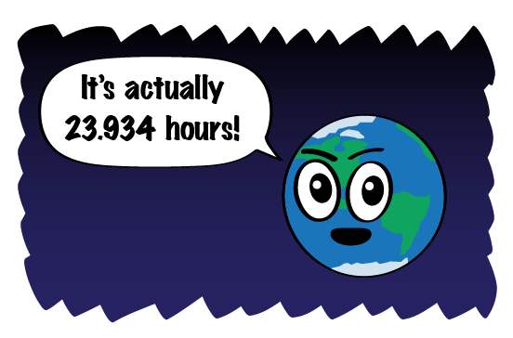
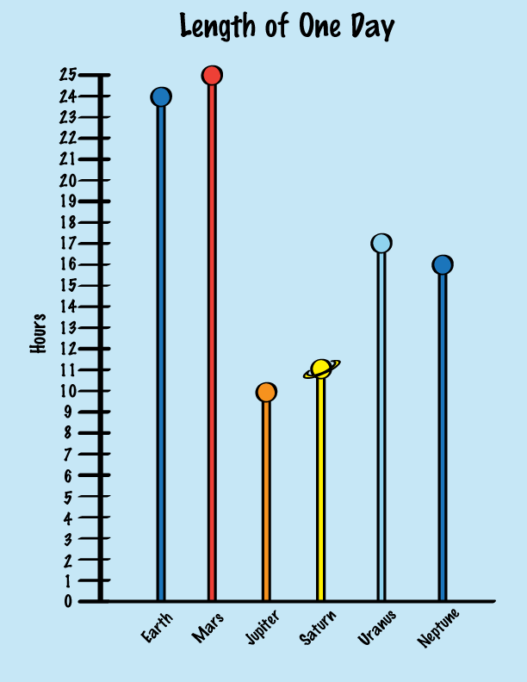
Concept Development
CFU 1
How long does it take for the Earth to complete one rotation on its axis?
Days
A day is a common unit of time based on the Earths rotation on its axis.
It takes 24 hours for the Earth to complete one rotation.
This is different on each planet, therefore the length of a day is different on each planet.
CFU 2
How long is a day on Earth?
CFU 3
It takes Neptune 16 hours to complete one rotation, how long is 10 days on Neptune?
Vocabulary
ax·is (verb) An imaginary straight line joining the North and South Poles ro·tat·ion (verb) One complete spin on an axis
Notes:
The cycle that goes from day through to night is known as a solar day. Because of earths elliptical orbit these can be a few minutes more or less than 24 hours.
A complete spin on the earths axis take 23 hours and 56 minutes and is known as a sidereal day.

Slide 4
Concept Development
CFU 1
What is a year?
Years
A year is the time it takes a planet to make one orbit around the sun.
There are eight planets in our Solar System that are orbiting the sun.
The speed and distance of each planets orbit is different, so the length of a year is different on every planet.
One orbit takes the Earth 365.25 days.
CFU 2
How long is one year on Earth?
CFU 3
A planet orbits the sun 5 times. How many years has the planet experienced?
CFU 3
Venus completes one orbit in 225 days. How many years does Venus experience in 450 days?
Vocabulary
or·bit (noun) The path an object takes around another

Slide 5
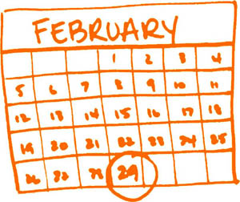
Concept Development
CFU 1
How far behind is our calendar every 4 years?
Years
A year is the time it takes a planet to make one orbit around the sun.
Because the Earth takes 365.25 days to orbit the sun, every 4 years our calendar is one full day behind.
We account for this by adding one extra day (29 February) every leap year.
CFU 2
Which day is added every 4 years?
CFU 3
Why is an extra day added every 4 years?
Vocabulary
or·bit (noun) The path an object takes around another

Slide 6
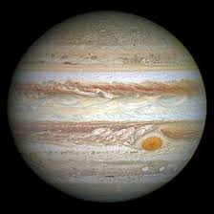
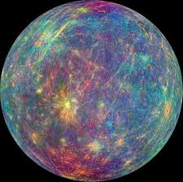
Skill Development/Guided Practise
CFU 1
How long is one day on each planet?
Comparing days on different planets
How long it takes for each planet to complete a rotation? Which planet has the longest day?
CFU 2
Which planet has the longest day?
Planet | Time of rotation (hours)
Mercury | 1,408
Venus | 5,832
Earth | 24
Mars | 25
Jupiter | 10
Saturn | 11
Uranus | 17
Neptune | 16
Compare a day on Mercury and Jupiter.
A day on Mercury is longer than a day on Jupiter. It takes Mercury 1,408 hours and Jupiter 10 hours to complete one rotation on their axis.

Slide 7
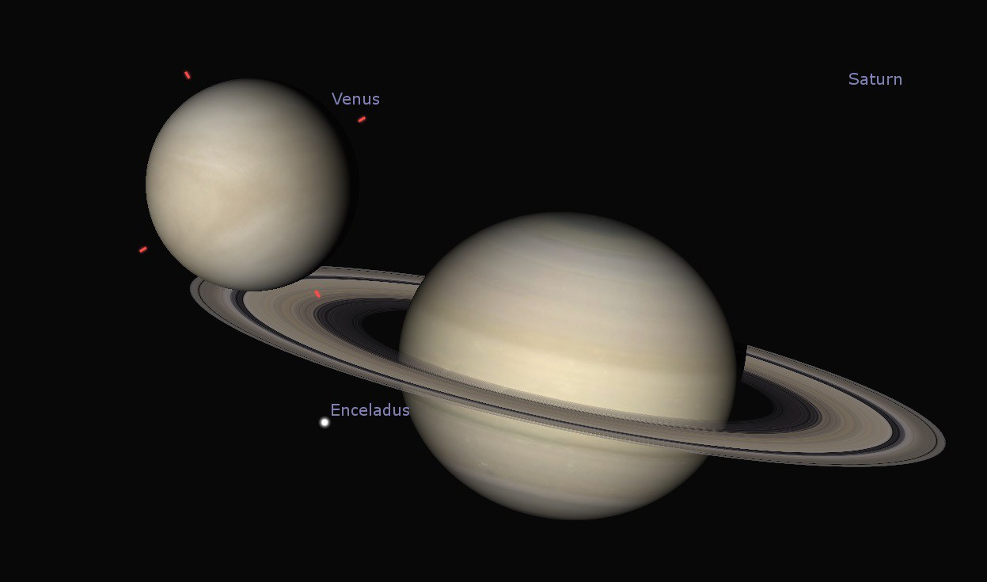
Skill Development/Guided Practise
CFU 1
How long is one day on each planet?
Comparing days on different planets
How long it takes for each planet to complete a rotation? Which planet has the longest day?
CFU 2
Which planet has the longest day?
Planet | Time of rotation (hours)
Mercury | 1,408
Venus | 5,832
Earth | 24
Mars | 25
Jupiter | 10
Saturn | 11
Uranus | 17
Neptune | 16
Compare a day on Saturn and Venus.
A day on _______ is longer than a day on _______. It takes _______ ____ hours and _______ ____ hours to complete one rotation on its axis.
A day on Venus is longer than a day on Saturn. It takes Venus 5,832 hours and Saturn 11 hours to complete one rotation on their axis.

Slide 8
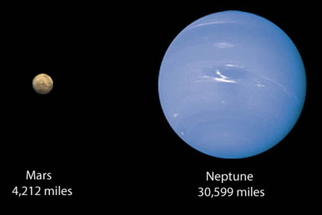
Skill Development/Guided Practise
CFU 1
How long is one day on each planet?
Comparing days on different planets
How long it takes for each planet to complete a rotation? Which planet has the longest day?
CFU 2
Which planet has the longest day?
Planet | Time of rotation (hours)
Mercury | 1,408
Venus | 5,832
Earth | 24
Mars | 25
Jupiter | 10
Saturn | 11
Uranus | 17
Neptune | 16
Compare a day on Mars and Neptune.
A day on _______ is longer than a day on _______. It takes _______ ____ hours and _______ ____ hours to complete one rotation on its axis.
A day on Mars is longer than a day on Neptune. It takes Mars 25 hours and Neptune 16 hours to complete one rotation on their axis.

Slide 9
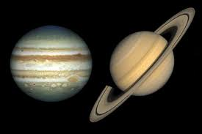
Skill Development/Guided Practise
CFU 1
How long is one day on each planet?
Comparing days on different planets
How long it takes for each planet to complete a rotation? Which planet has the longest day?
CFU 2
Which planet has the longest day?
Planet | Time of rotation (hours)
Mercury | 1,408
Venus | 5,832
Earth | 24
Mars | 25
Jupiter | 10
Saturn | 11
Uranus | 17
Neptune | 16
Compare a day on Saturn and Jupiter.
A day on _______ is longer than a day on _______. It takes _______ ____ hours and _______ ____ hours to complete one rotation on its axis.
A day on Saturn is longer than a day on Jupiter. It takes Saturn 11 hours and Jupiter 10 hours to complete one rotation on their axis.

Slide 10
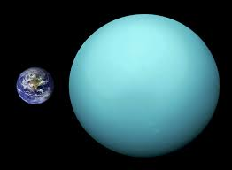
Skill Development/Guided Practise
CFU 1
How long is one day on each planet?
Comparing days on different planets
How long it takes for each planet to complete a rotation? Which planet has the longest day?
CFU 2
Which planet has the longest day?
Planet | Time of rotation (hours)
Mercury | 1,408
Venus | 5,832
Earth | 24
Mars | 25
Jupiter | 10
Saturn | 11
Uranus | 17
Neptune | 16
Compare a day on Uranus and Earth.
A day on _______ is longer than a day on _______. It takes _______ ____ hours and _______ ____ hours to complete one rotation on its axis.
A day on Earth is longer than a day on Uranus. It takes Earth 24 hours and Uranus 17 hours to complete one rotation on their axis.

Slide 11
Skill Development/Guided Practise
CFU 1
How long is one year on each planet?
Comparing years on different planets
How long it takes for each planet to complete one orbit? Describe the difference between the length of a year on each planet.
CFU 2
Which planet has the longest year?
Planet | Time of orbit (Earth days)
Mercury | 88
Venus | 225
Earth | 365.25
Mars | 687
Jupiter | 4,333
Saturn | 10,759
Uranus | 30,234
Neptune | 60,152
Compare a year on Mercury and a year on Jupiter.
A year on Jupiter is longer than a year on Mercury. It takes Jupiter 4,333 days and Mercury 88 days to complete one orbit of the Sun.

Slide 12
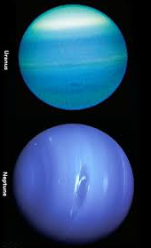
Skill Development/Guided Practise
CFU 1
How long is one year on each planet?
Comparing years on different planets
State the planet with the longest year. Describe the length of the year on each planet.
CFU 2
Which planet has the longest year?
Planet | Time of orbit (Earth days)
Mercury | 88
Venus | 225
Earth | 365.25
Mars | 687
Jupiter | 4,333
Saturn | 10,759
Uranus | 30,234
Neptune | 60,152
Compare a year on Uranus and a year on Neptune.
A year on Neptune is longer than a year on Uranus. It takes Neptune 60,152 days and Uranus 88 days to complete one orbit of the Sun.
A year on _______ is longer than a year on _______. It takes _______ ____ days and _______ ____ days to complete one orbit of the sun.

Slide 13
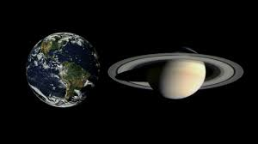
Skill Development/Guided Practise
CFU 1
How long is one year on each planet?
Comparing years on different planets
How long it takes for each planet to complete one orbit? Describe the difference between the length of a year on each planet.
CFU 2
Which planet has the longest year?
Planet | Time of orbit (Earth days)
Mercury | 88
Venus | 225
Earth | 365.25
Mars | 687
Jupiter | 4,333
Saturn | 10,759
Uranus | 30,234
Neptune | 60,152
Compare a year on Earth and a year on Saturn.
A year on Saturn is longer than a year on Earth. It takes Saturn 10,759 days and Earth 365 days to complete one orbit of the Sun.
A year on _______ is longer than a year on _______. It takes _______ ____ days and _______ ____ days to complete one orbit of the sun.

Slide 14
Skill Development/Guided Practise
CFU 1
How long is one year on each planet?
Comparing years on different planets
State the planet with the longest year. Describe the length of the year on each planet.
CFU 2
Which planet has the longest year?
Planet | Time of orbit (Earth days)
Mercury | 88
Venus | 225
Earth | 365.25
Mars | 687
Jupiter | 4,333
Saturn | 10,759
Uranus | 30,234
Neptune | 60,152
Compare a year on Venus and a year on Saturn.
A year on Saturn is longer than a year on Venus. It takes Saturn 10,759 days and Venus 225 days to complete one orbit of the Sun.
A year on _______ is longer than a year on _______. It takes _______ ____ days and _______ ____ days to complete one orbit of the sun.

Slide 15
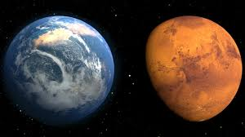
Skill Development/Guided Practise
CFU 1
How long is one year on each planet?
Comparing years on different planets
How long it takes for each planet to complete one orbit? Describe the difference between the length of a year on each planet.
CFU 2
Which planet has the longest year?
Planet | Time of orbit (Earth days)
Mercury | 88
Venus | 225
Earth | 365.25
Mars | 687
Jupiter | 4,333
Saturn | 10,759
Uranus | 30,234
Neptune | 60,152
Compare a year on Earth and a year on Mars.
A year on Mars is longer than a year on Earth. It takes Mars 687 days and Earth 365 days to complete one orbit of the Sun.
A year on _______ is longer than a year on _______. It takes _______ ____ days and _______ ____ days to complete one orbit of the sun.

Slide 16
Relevance
Knowing about the Earth and space will help you understand and explain natural process that happen on Earth, including tides and seasons.

Slide 17
Skill Closure
It takes 10 hours for Jupiter to complete one rotation on its axis. How long is 2 days on Jupiter?
What is a year?
Compare a day and a year on Venus. (to convert hours to days divide by 24)
Name two planets that orbit the Sun faster than Earth.
Skill Closure
Skill Closure
Planet | Time of rotation (hours) | Time of orbit (Earth days)
Mercury | 1,408 | 88
Venus | 5,832 | 225
Earth | 24 | 365.25
Mars | 25 | 687
Jupiter | 10 | 4,333
Saturn | 11 | 10,759
Uranus | 17 | 30,234
Neptune | 16 | 60,152
Skill Closure
Notes:
5832/24= 243 days

Slide 18
Independent Practice
Copy and complete the table below to find out what your age would be on different planets (you will need a calculator or device).
My age in Earth years is ________
Planet | Calculation required | My age on the planet
Mercury | Multiply your age by 365 then divide by 88
Venus | Multiply your age by 365 then divide by 225
Earth | Do nothing
Mars | Multiply your age by 365 the divide by 687
Jupiter | Divide your age by 12
Saturn | Divide your age by 29.5
Uranus | Divide your age by 84
Neptune | Divide your age by 164.8
2. On which planets would you be the oldest and the youngest? Explain why these two planets make you these ages.

